Slide 1
Ray Tracing on FPGA
Nikolas Koxenoglou – Diploma thesis proposal

Slide 2
My OpenGL Project
An idea to avoid a final exam ..
Turned into an idea for my diploma thesis
It involves me using OpenGL to understand the maths that use to produce graphics
A museum styled corridor that displays “exhibits” which display all the things we learned in the OpenGL course

Slide 3
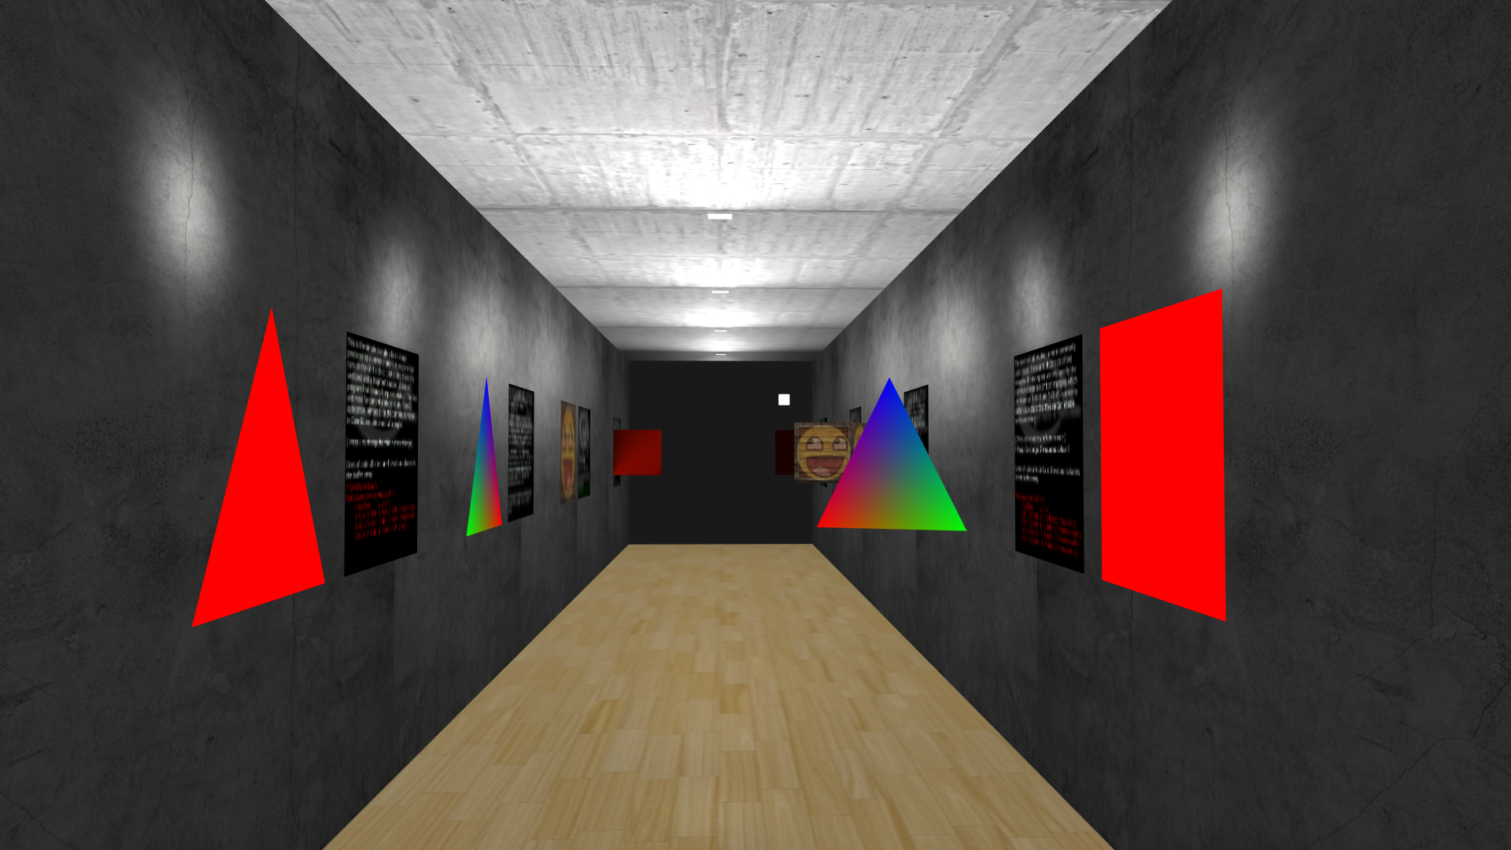
A small peak

Slide 4
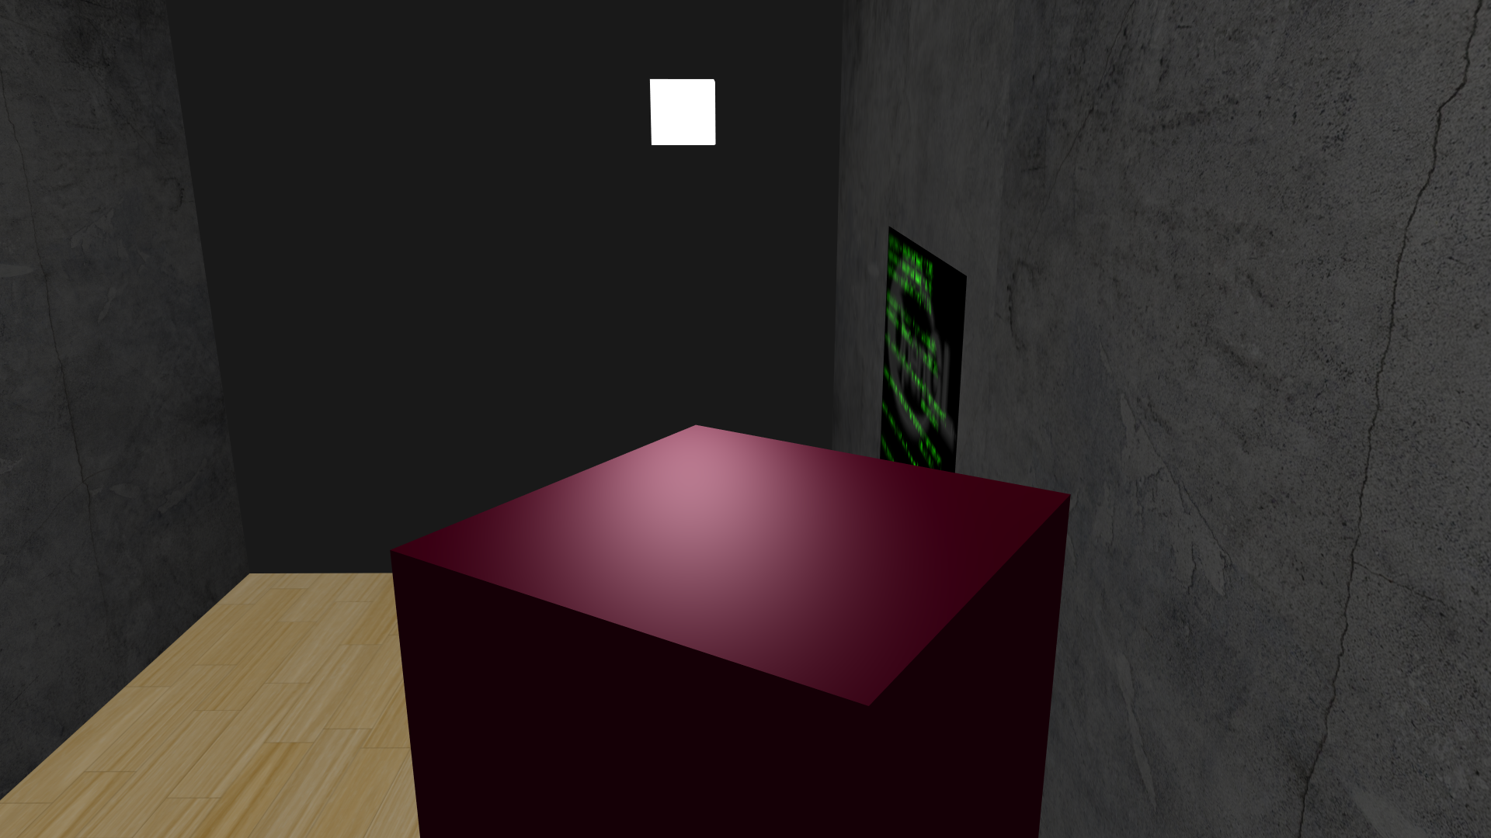
A small peak

Slide 5
My OpenGL Project
As you can observe this scene although beautiful still lacks fancy graphics and shadows etc.
This a very simple OpenGL implementation
In creating this project I became interested in working with graphics
It is an interesting field with many problems that need solutions

Slide 6
Graphics pipeline
OpenGL is colouring pixels with a processes called rasterization
It projects triangles on the view plane using perspective projection and then fills them
GPUs are build to rasterize
Rasterization can only get you so far
Greater graphical fidelity at the cost of greater complexity ( production time and cost increase )
Last major graphics upgrade: Crisis ( 2007 )
But can it run Crisis ??

Slide 7
History
The first Ray Tracing scene took 2 weeks to render at Bell Labs 1978
“ The Compleat Angler “ – Turner Whitted
First true Ray Tracing
A good looking but still lacking scene
Today it is still a very demanding process
Used in game-engines and more

Slide 8
What is Ray Tracing
A rendering method based on Ray Casting ( Wolfenstein 3D - 1992 )
Ray Tracing adds recursion to a casted ray
Additional rays generate from the point of intersection for various effects
Adds depth and complexity to a scene by tracing the path of light or shadow sources in order to evaluate the colour of a pixel
Each pixel can be calculated independently from other pixels

Slide 9
Why Ray Tracing
It is an interesting method that produces stunning images and scenes
Implementing it has great computational cost
It has good parallelizable potential
A more sensible method for creating

Slide 10
What Problems Can be Solved
Nvidia is using a combination of Ray Tracing and rasterization
Small number of rays
Using de-noising hardware to fix the image
The main problem Ray Tracing solves are graphical FX rendering problems
There is a case to be made by utilising a form of the algorithm in other problems as well
A real or near real-time ray tracing implementation will save a lot of time in various work environments that utilize it

Slide 11
What I want to accomplish
I want to further familiarise myself with Digital Design using FPGAs
Work on an idea that excites me
Develop, implement and optimize an FPGA project
This will represent what I can accomplish when properly working on a project

Slide 12
What is Planned
The plan is to define the problem to be solved with more detail
Build a testing environment along with golden samples to verify the progress and correctness of the project
Develop the accelerator main architecture in a modular fashion
Build a base implementation with no optimizations

Slide 13
Sources
https://www.cs.unc.edu/~rademach/xroads-RT/RTarticle.html
https://en.wikipedia.org/wiki/Ray_tracing_(graphics)

